Slide 1


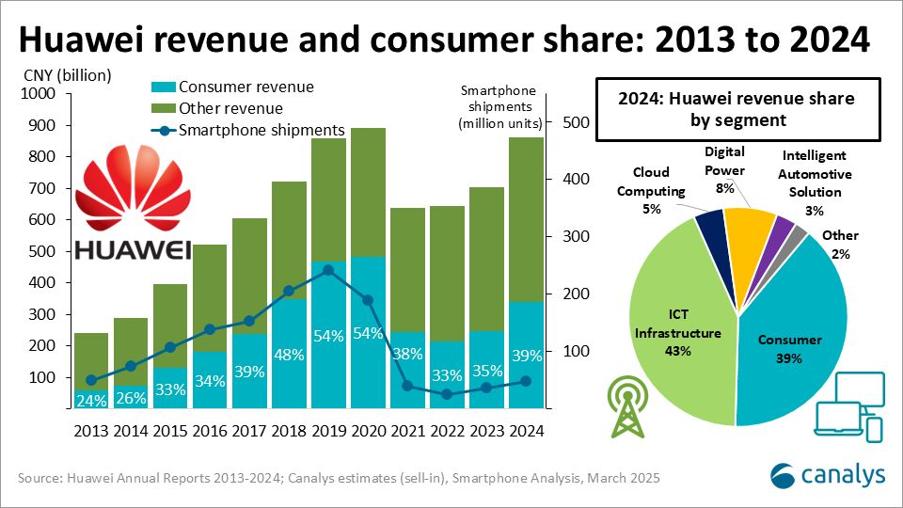


Reflective Presentation on Huawei’s Strategic Planning and Personal Learning
Introduction & Purpose
  Purpose: To reflect on learning from Assessment 1 (Huawei essay).
  Framework: Gibbs’ Reflective Cycle (1988).
  Focus: Understanding management functions & strategy tools.
  Goal: Demonstrate personal and professional development.
Notes:
In this reflection, I used Gibbs Reflective Cycle (1988) to revisit what I got to know in the module and when writing my essay on Huawei's strategic planning approach to enter the European market. It discusses how I applied management functions and tools of strategy like PESTLE, SWOT, and Porter's Five Forces and how the experience helped me put into better perspective my research, analytical, and reflective skills in approaching management issues more efficiently.

Slide 2






Learning from Assessment 1
Key Takeaways
  Gained insights on global strategy and leadership.
  Understood Huawei’s adaptability via localisation.
  Faced difficulty applying multiple models.
  Overcame this through structured research and reflection.
Notes
  Researching Huawei, I got to know how global companies can adjust to the local environment using localisation and innovation. Initially, it was rather challenging to combine the frameworks, and the review of open-access research helped me to learn more. Huan and Midhunchakkaravarthy (2024, p. 1) describe how the Chinese companies move to other countries worldwide to “boost profitability and avoid local competition,” demonstrating how the strategic objectives relate theory to practice and enhance the planning and organising capabilities.

Slide 3


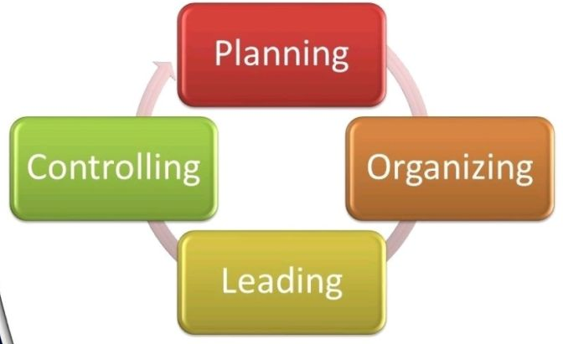
Understanding Management Functions (PLOC)
Notes
  Planning: Anticipating regulatory and market uncertainty.
  Leading: Transformational leadership drives innovation.
  Organising: Aligning R&D, supply chains, and talent.
  Controlling: Evaluating compliance and sustainability goals.
I was able to realise that planning plays a crucial role in the development of strategic direction. Based on the works of Adriaans et al. (2025, p. 1-3), I got to know the way Huawei addresses paradoxes and makes strategic choices to reach its targets. This realisation also emphasised that effective planning must balance tensions between strategy, process, and context and be flexible. It further affirmed that planning, flexibility, and well-coordinated planning are what can make the long-term organisational vision and sustainability.

Slide 4
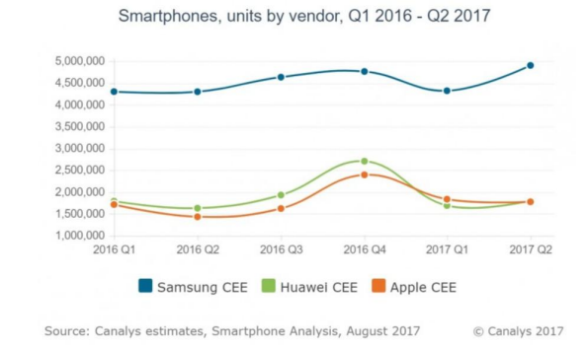





Applying Strategic Tools
  PESTLE: Political and legal pressures dominate.
  SWOT: Strength in 5G innovation; weakness in trust.
  Porter’s Five Forces: High competition and entry barriers.
  Value Chain: R&D and logistics are key strengths.
  Tools revealed strategic opportunities and ethical challenges.
Notes
The use of strategic tools enhanced my thinking. The PESTLE model demonstrated how the political and economic situation influenced the strategy of Huawei, and SWOT demonstrated its strong innovational features and issues with trust. According to Jin and Yin (2020, p. 1139), Huawei “uses low prices and strong promotional efforts to quickly occupy the market,” reflecting cost leadership. When combined with Porter's Five Forces, this helped me in understanding competitive advantage better.

Slide 5


Personal Development
  Improved academic writing and referencing skills.
  Gained confidence interpreting theories critically.
  Enhanced ability to synthesise multiple frameworks.
  Developed reflective and analytical thinking.
Notes:
In the course of the process, my writing and research skills have enhanced. I was taught to be sceptical of assumptions and cross-reference theories. My analysis of corporate statements was reinforced by comparing the internal sources with independent reports (Huawei, 2024). Concise but precise writing developed discipline, and rumination facilitated the process of analysis into understanding and made me independent and more curious about management practice.

Slide 6

Future Application
  Use planning and critical analysis in subsequent modules.
  Evaluate complicated business issues using strategy frameworks.
  Be ethically conscious and evidence-based.
  Promote flexibility and lifelong learning.
Notes
I will use these skills in my future studies and career. I have now developed the approach of looking at challenges in management by examining the forces outside and marshalling internal strengths. I will focus on ethical and sustainable strategies with the help of such tools as SWOT and PESTLE. Carrera (2022, p. 2) states that corporate social responsibility assists to “restore continuity between business activities and their long-term effects,” and sustainable decision-making is achieved.

Slide 7





Conclusion & Key Takeaways
  The most influential management lens is planning.
  Decision-making and perspective were enhanced using strategic tools.
  The reflection enhanced knowledge of leadership and ethics.
  Devoted to development and long-path learning.
Notes
As a reflection on the module, I can say that planning is the most crucial management role, particularly in uncertain global environments. The application of strategic tools helped me to combine evidence and judgement. I have not only grown in the area of academic knowledge, but also I have learnt to think in a certain way, be resilient, and be ethical. Constant reflection will also help me develop as a student and a manager who will make informed decisions in a sustainable manner.

Slide 8
References
Huan, J. and Midhunchakkaravarthy, D. (2024) ‘Achievements in Technological Innovation’, Cuestiones de Fisioterapia, 53(3), https://cuestionesdefisioterapia.com/index.php/es/article/view/3430
Adriaans, J. et al. (2025) An Examination of Huawei’s Strategic Decisions: Balancing Tensions for Sustainable Growth. https://www.researchgate.net/publication/380721702_An_Examination_of_Huawei's_Strategic_Decisions_Balancing_Tensions_For_Sustainable_Growth
Jin, S. and Yin, J. (2020) ‘Research on marketing strategy of Huawei mobile phone in European market’, Academic Journal of Business & Management, 2(5). https://real.mtak.hu/166436/1/14-33.pdf
Huawei Technologies Co., Ltd. (2024) Annual Report 2024. Available at: https://www.huawei.com/minisite/annual-report-download/annual_report_2024_en.pdf
Carrera, L. (2022) ‘Corporate social responsibility: A strategy for social and territorial sustainability’, International Journal of CSR, 7(1), p. 1148. Available at: https://link.springer.com/article/10.1186/s40991-022-00074-0
AI Acknowledgement Statement
I have used ChatGPT to have a clearer understanding of what format and type of content I will use in the work. The prompt I have used include, which is the best format for the work and which structure is best to use for the ppt? Also i used grammarly correct spelling mistakes. What was generated from these prompts was used to guide me through formatting and styling the presentation slides

